Slide 1
STATEMENT
Project Name
Cancer Detection
DhetchanaMoorthi.A (9923151019)
Marieswaran.R (9923151050)
Karthikeyan.P (9923151067)
Ramakrishnan.R (9923151132)
DATE: 15/04/2024
Guided by
Dr. K. Indhumathi

Slide 2
ABSTRACT
Develop a deep learning model for early cancer detection using CNNs or RNNs to analyze medical imaging data.
Preprocess data to enhance model performance.
Benefits include enhanced accuracy in cancer detection, automation of diagnostic processes, and potential for personalized treatment plans.
Challenges include ensuring data quality, addressing biases, interpreting complex model decisions, managing computational resources, and data privacy.
Despite challenges, leveraging deep learning for cancer detection holds immense promise in revolutionizing healthcare, improving patient care, and outcomes.

Slide 3
REQUIREMENTS
1. SOFTWARE REQUIREMENTS:
Frontend: HTML, CSS, JS
Backend : Python (Tensorflow, Keras)
2. HARDWARE REQUIREMENTS:
OS : Windows 10
Ram: 8gb
Rom: 256 gb

Slide 4
OBJECTIVES
Advantages:
Improved accuracy
Automation reduces workload
Scalable for large datasets
Potential for personalized medicine
Continuous improvement with new data

Slide 5
MODULES
Data Collection: Gathering medical imaging data, possibly from various sources, ensuring it's comprehensive and relevant for the intended application.
Data Preprocessing: Cleaning and organizing the collected data, handling missing values, standardizing formats, and performing any necessary transformations to make it suitable for model training.
Model Development: Creating the architecture and components of the deep learning model, including defining layers, activation functions, and optimization algorithms based on the problem requirements.
Training: Utilizing the prepared dataset to train the deep learning model, where the model learns to make predictions by adjusting its parameters based on the input data.
User Interface: Designing and implementing a simple and intuitive interface for users to interact with the deployed model, facilitating input of new data and interpretation of model outputs.
METHODOLOGY

Slide 6
ANALYSIS
Analysis
Dataset collection
Categorization
[lung_aca, Lung_scc,
Lung_n]

Slide 7
CONCLUSIONS
Deep learning presents significant potential in cancer detection, offering improved diagnostic accuracy, workflow automation, and advancements in personalized medicine.
Advantages include enhanced accuracy, scalability, and the potential for tailored treatments.
Challenges such as data quality, interpretability, and ethical considerations require careful attention.
Despite hurdles, continuous model improvement underscores deep learning's importance in revolutionizing cancer diagnosis and patient care.
Addressing these challenges is essential for realizing the full potential of deep learning in healthcare.
Overall, deep learning holds immense promise in transforming cancer detection and improving patient outcomes.

Slide 8
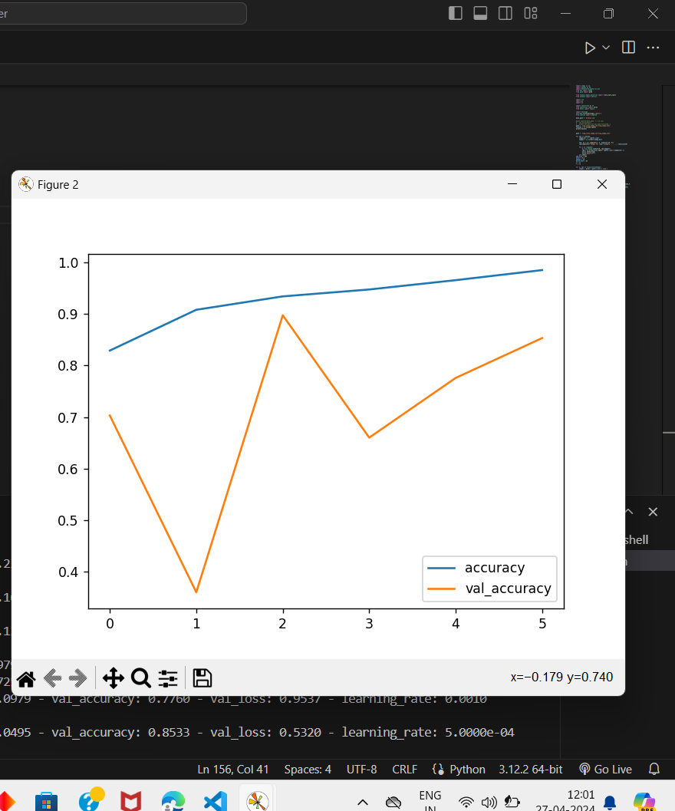

Slide 9
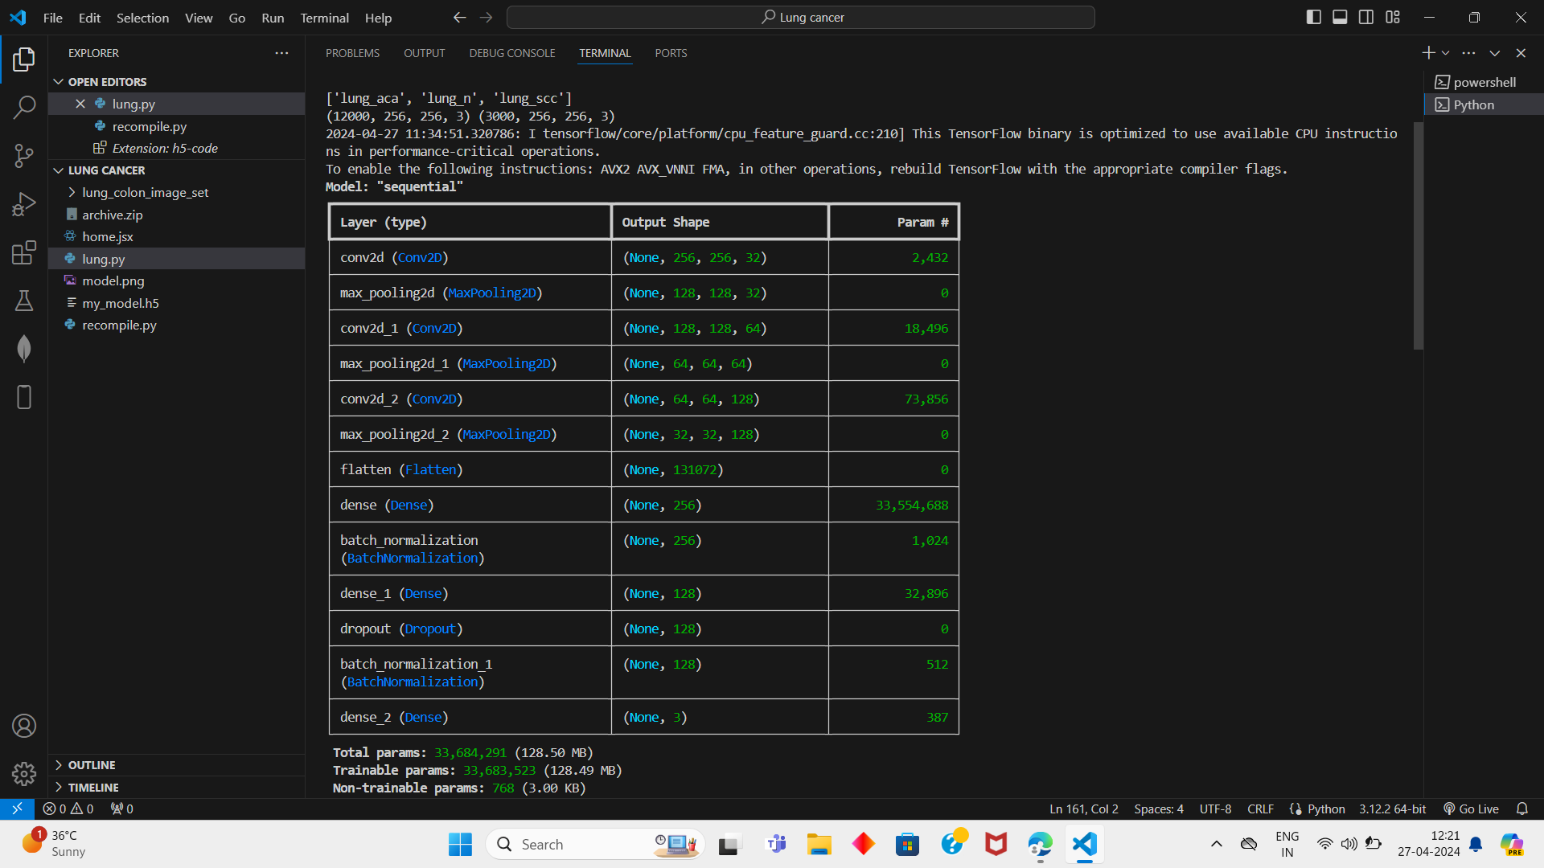

Slide 10
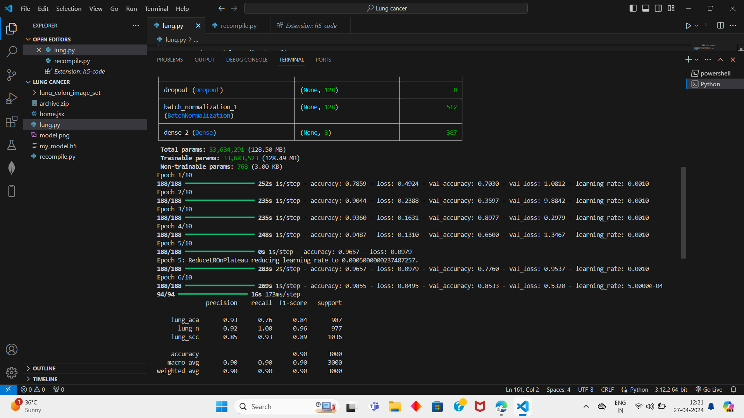

Slide 11
STATEMENT
THANK YOU

